Slide 1


Class Attendance System Based On Face Detection And Recognition
CE352 Software Group project-III
Presented By:
Parthiv Patel (18DCE084)
Shaunak Patel (18DCE086)
Saumya Raval (18DCE103)
Kashyap Shah (18DCE115)
Guided By: Atufaali Saiyed (Assistant Prof. - IT)
Charotar University of Science and Technology
Devang Patel Institute of Advanced Technology and Research

Slide 2
OUTLINE
Introduction
Objective
Current system & problems of the system
Project Work Scheduling
Proposed system and scope of the system
Hardware and software requirements
Flowchart
Implementation Screenshots
Limitations
Role
References

Slide 3
Introduction
As we know that the current way of manually taking attendance of each student is not efficient .
To overcome this we will implement class attendance system that uses face detection and recognition technique.
This will be a very quick way to take attendance of the class, Also chances of proxy will be zero.

Slide 4
Objective
The main objective of this project is to develop face recognition based automated student attendance system. In order to achieve better performance, the test images and training images of this proposed approach are limited to frontal and upright facial images that consist of a single face only. The test images and training images have to be captured by using the same device to ensure no quality difference. In addition, the students have to register in the database to be recognized. The enrolment can be done on the spot through the user-friendly interface.

Slide 5


Current system & problems of the system
Traditionally attendance is marked manually by teachers and they must make sure correct attendance is marked for respective student.
This whole process wastes some of lecture time and part of correct information is missed due to fraudulent and proxy cases.

Slide 6
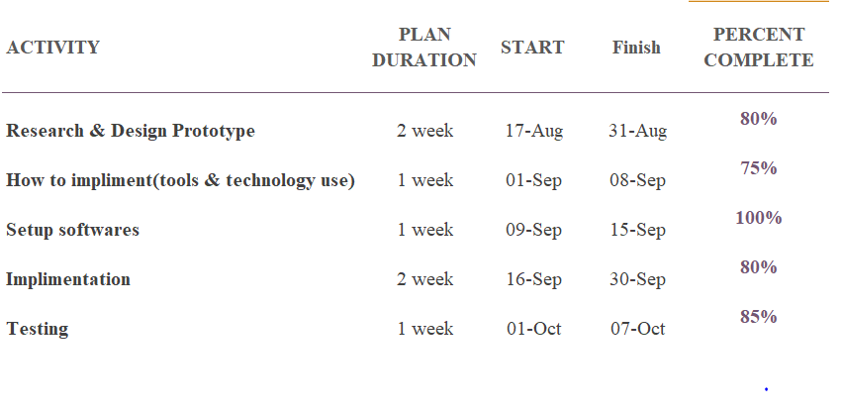
Project Work Scheduling
Fig. 1 Gantt Chart

Slide 7
Proposed System and scope of the system
The proposed system will automatically mark attendance of the students present inside the classroom at given particular time.
Whenever a we put an image as input it first detects the faces in the image.
Then it takes around 128 measurement values from each face and matches these values with the database images.
A frame of around the person is formed when it is matched with a picture from database.
Less paper work gives environmental effect

Slide 8
Hardware and software requirements
Software
Pycharm(IDE),Desktop developer for C++
Windows 7/8/10
Framework Used:
Streamlit
Library:
openCV
Face_detection
Numpy
Cmake
Dlib
Hardware
500 GB Hard Disk
Standard LED Monitor
Min. 4gb ram Laptop/PC with Webcam and keyboard

Slide 9
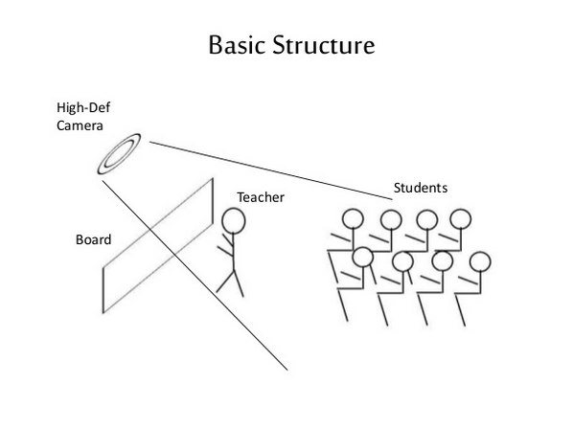
Fig. 2 Basic Structure

Slide 10
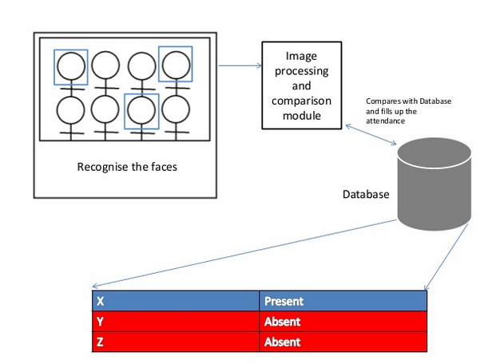
Fig. 3 Attendance Taking Process

Slide 11
Flowchart
Acquire RCB Image
Convert RCB Image to gray scale
Apply Detection
Extract face from image
Resize extracted face image
Recognize face
Compare recognize face details with dataset
Attendance updated

Slide 12
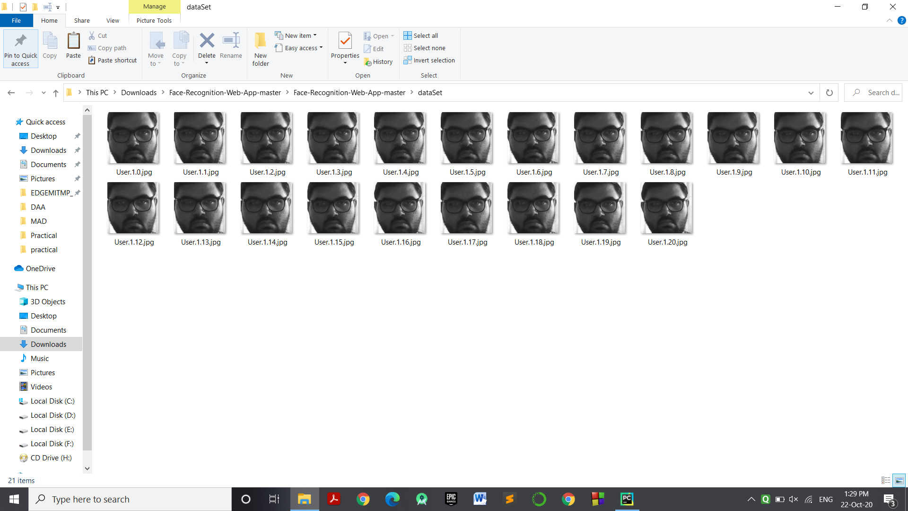
Implementation Screenshots
Fig. 4 dataset folder (captured images are converted into greyscale and then stored)

Slide 13
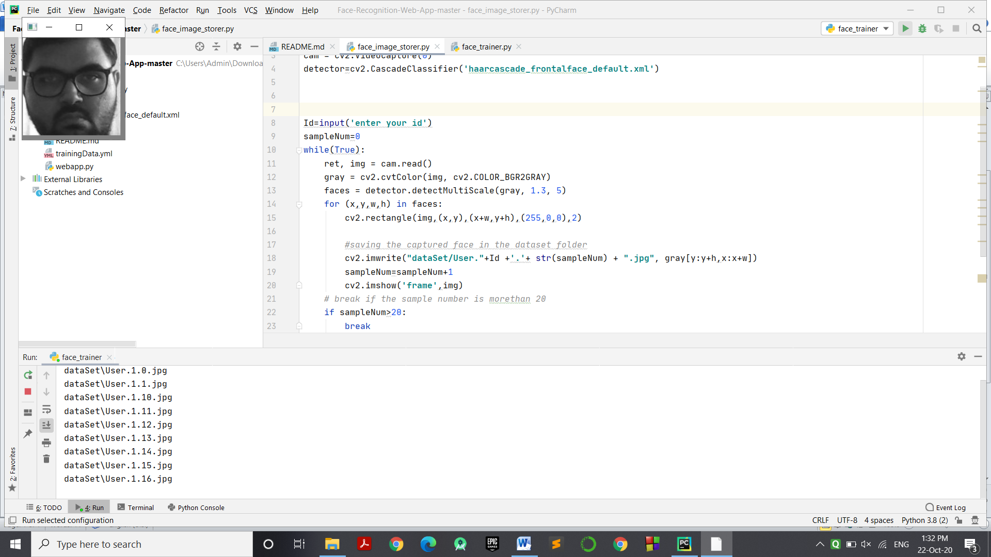
Implementation Screenshots Continue..
Fig. 5 Face Training

Slide 14
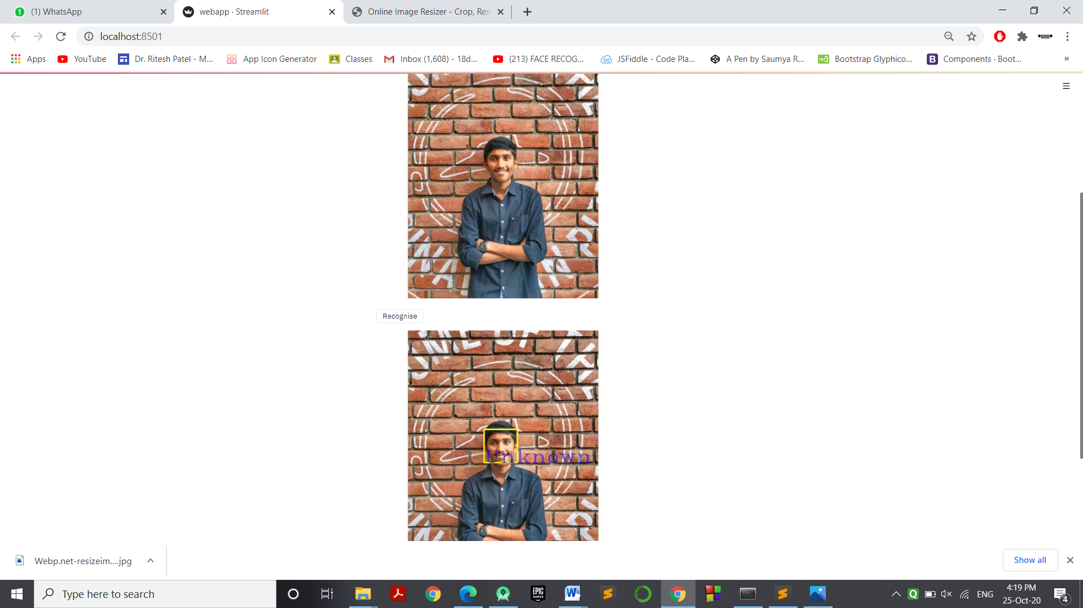
Implementation Screenshots Continue..
Fig. 6 Webapp, Face is detected but not recognized, so unknown

Slide 15
Limitations
The input image for the proposed approach has to be frontal, upright and only a single face. Although the system is designed to be able to recognize the student with glasses and without glasses, student should provide both facial images with and without glasses to be trained to increase the accuracy to be recognized without glasses. The training image and testing image should be captured by using the same device to avoid quality difference. The students have to register in order to be recognized. The enrolment can be done on the spot through the user-friendly interface. These conditions have to be satisfied to ensure that the proposed approach can perform well.
Different level of brightness or lighting could be a challenging problem for face recognition.
One of the problems in real-time face recognition is the difficulty to obtain sufficient and suitable images for training and testing purpose. It is hard to obtain in real-time databases with a variety of variables, and it is hard to obtain publicly available databases.

Slide 16
Role
Saumya Raval:
Installation of all libraries and setting up the IDE(i.e. Pycharm)
Shaunak Patel:
Understanding how face det. & recognition works
Parthiv Patel:
Research on image processing and labeling.
Kashyap Shah:
Simple Program to detect faces and recognize them, developing project report and presentation.

Slide 17
References:
https://medium.com/@ageitgey/machine-learning-is-fun-part-4-modern-face-recognition-with-deep-learning-c3cffc121d78
https://medium.com/@Intellica.AI/a-guide-for-building-your-own-face-detection-recognition-system-910560fe3eb7
https://www.youtube.com/c/TechWithTim

Slide 18
THANK YOU

